Slide 1
Scaling Spark in the Real World : Performance and Usability
Author: Michael Armbrust, Tathagata Das, Aaron Davidson, Ali Ghodsi, Andrew Or, Josh Rosen, Ion Stoica, Patrick Wendell, Reynold Xin, Matei Zaharia.
Type: Industry Paper
Presented by:
Ranjan
Fall 2015

Slide 2
Motivation
What is Spark?
Why is Spark required?
Problems?

Slide 3
Related Work
In this paper, related work was not evaluated in detail
Most of the references lead to more information about SPARK

Slide 4
Contribution
Memory Management
Networking Layer
Debugging Tools
Data frame API

Slide 5
Conclusion
In addition to the contributions mentioned in the previous slides, following work is still ongoing and being carried out by the authors
Usability: Standard Libraries(ML lib) and a pluggable data source API(Graph X).
Performance: Memory management outside the JVM,
To limit of the underlying hardware.

Slide 6
A Framework for Clustering Uncertain Data
Presented by: Dardan Xhymshiti
Fall 2015

Slide 7
A Framework for Clustering Uncertain Data
Type: Demonstration paper
Authors:
International conference on Very Large Data Bases.
Erich Schubert | Alexander Koos | Tobias Emrich
Andreas Zufle | Klaus Arthur Schmid | Arthur Zimek
Ludwing-Maximilians-Universitat Munchen

Slide 8
Major problem
Data sets contains a lot of uncertain data.
Quality of the data implies the quality of the mining results.

Slide 9
Major motivation
Simply ignoring that data objects are:
Imprecise,
Obsolete,
Unreliable
Pretending that the data is:
Current
Accurate
Is a common source of false decision making.
How to get reliable results from uncertain data?

Slide 10
Major work
The paper targets the problem of how to derive meaningful clustering from an uncertain data:
The authors extend the ELKI framework for handling uncertain data.
ELKI is an open source data mining software written in Java concentrated on unsupervised methods such as cluster analysis and outlier detection.

Slide 11
Major contribution
ELKI 7.0 adds support for the most commonly used uncertainty models.
The ELKI visualization tools have been extended to support the clustering of uncertain data.
Have been added comparison algorithms for clustering uncertain data for specific uncertainty models

Slide 12
CODD: A Dataless Approach to Big Data Testing
Presented by: Dardan Xhymshiti
Fall 2015

Slide 13
CODD: A Dataless Approach to Big Data Testing
Paper type: Demo
Authors: Ashoke S., Jayant R. Harits (Indian Institute of Science, Bangalore)
Conference: VLDB

Slide 14
Major problem
The data management community has been almost completely focused on construction and development of Big Data systems. A little attention was paid to testing such systems.
Traditional testing techniques involving:
Construction of databases
Regression query suites
are not practicable at Big Data Scale

Slide 15
Major motivation
The lack of efficient testing tools for Big Data systems.

Slide 16
Major contribution
The authors have implemented a graphical tool called CODD (Constructing Dataless Databases).
This tool can simulate data base environments with the desired meta-data characteristics without the need to store any content.
CODD has implemented a sort-based algorithm to ensure that meta-data input by the user are both legal and consistent.
CODD deals with the Volume aspect of Big Data.
CODD is written in Java, running 50K LOC.

Slide 17
Gobblin: Unifying Data Ingestion for Hadoop
Presented by: Omar Alqahtani
Fall 2015

Slide 18
Authors
Lin Qiao, Yinan Li, Sahil Takiar, Ziyang Liu, Narasimha Veeramreddy, Min Tu, Ying Dai, Issac Buenrostro, Kapil Surlaker, Shirshanka Das, Chavdar Botev
LinkedIn Inc.
VLDB Endowment, Vol. 8, No. 12 - 2015

Slide 19
Motivation/Problem
LinkedIn’s data sources have become increasingly heterogeneous.
Espresso, Kafka, Voldemort , Oracle, MySQL, RocksDB
S3, Salesforce, Google Analytics, etc.
Needs to be loaded into their Hadoop clusters to feed business- or consumer- oriented analysis.

Slide 20
Previous Approach
Separate data ingestion pipeline for each data source.
Dozen different pipelines.
re-implementing the HashMap
No scalability
Hard to maintenance

Slide 21
Contribution
Gobblin, a generic data ingestion framework for Hadoop.
Source integration
Processing paradigm
Extensibility
Self-service
Data quality assurance

Slide 22
Related Work
Apache Sqoop: a generic framework for multiple types of sources and destinations. But,
Gobblin focus on a unification of continuous streaming ingestion with scheduled batch ingestion.
Differ in the modularity and componentization.
Other specialized open-source tools: Apache Flume, Aegisthus, Morphlines

Slide 23
An Architecture for Compiling UDF-centric Workflows
Presented by: Ashkan Malekloo
Fall 2015

Slide 24
An Architecture for Compiling UDF-centric Workflows
Type: Research paper
Authors:
International conference on Very Large Data Bases.
Andrew Crotty, Alex Galakatos, Kayhan Dursun, Tim Kraska, Carsten Binnig, Ugur Cetintemel, Stan Zdonik

Slide 25
Introduction
This Paper describes a novel architecture for automatically compiling workflows of UDFs.
This Paper also proposes several optimizations that consider properties of the data, UDFs, and hardware together in order to generate different code on a case-by-case basis.

Slide 26
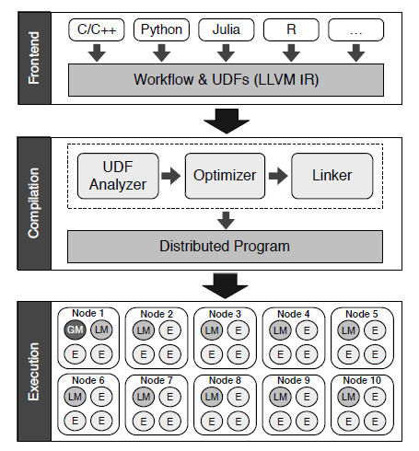
Architecture
Their Architecture leverages the LLVM compiler framework

Slide 27
Related works
Programming Models
System ML
DryadLINQ
Single Node Framework
Phoenix++

Slide 28
Related works
Programming Models
System ML
DryadLINQ
Single Node Framework
Phoenix++

Slide 29
PARADIS: An Efficient Parallel Algorithm for Inplace Radix Sort
Presented by: Ashkan Malekloo
Fall 2015

Slide 30
PARADIS: An Efficient Parallel Algorithm for Inplace Radix Sort
Type: Research paper
Authors:
International conference on Very Large Data Bases.
Minsik Cho, Daniel Brand, Rajesh Bordawekar, Ulrich Finkler, Vincent Kulandaisamy, Ruchir Puri

Slide 31
Introduction
In-place radix sort is a popular distribution-based sorting algorithm
For two reasons, efficient parallelization of in-place radix sort is challenging

Slide 32
In-place Radix Sort
Radix sort can be one of the best suited sorting kernels for many in-memory data analytics
Simplicity
Efficiency
Especially in-place radix sort, which performs sorting without extra memory overhead, is highly desirable for in-memory operation for two reasons

Slide 33
Contribution
A speculative permutation followed by repair which are both efficiently parallelized. By iterating these two steps, PARADIS permutes all array elements into their buckets, fully in parallel and in-place.
A distribution-adaptive load balancing technique for recursive invocations of the algorithm on the resulting buckets.
Notes:
PARADIS minimizes the elapsed run-time by adaptively allocating more processors to larger buckets.

Slide 34
Association Rules with Graph Patterns {wenfei@inf, jingbo.xu@}.ed.ac.uk, xinwang@swjtu.cn, yinghui@eecs.wsu.edu
Presented by: Zohreh Raghebi
Fall 2015

Slide 35
Motivations
Association studied for discovering regularities between items in relational data
Interests in studying associations between entities in social graphs
Such associations are useful in social media marketing
“90% of customers trust peer recommendations versus 14% who trust advertising”
“60% of users said Twitter plays an important role in their shopping”

Slide 36
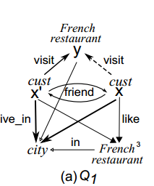
Introduction
Identify potential customers by exploring social influence
The antecedent of the rule represented as a graph pattern and the consequent is indicated by a edge
In a social graph G, for x and y satisfying the antecedent Q1 via graph pattern matching, we can recommend y to x.

Slide 37
Challenges
(1) Conventional support and confidence metrics no longer work for GPARs
(2) Mining algorithms for traditional rules and frequent graph patterns cannot be used to discover for GPARs.
(3) A major application of GPARs is to identify potential customers in social graphs
This is costly: graph pattern matching by subgraph isomorphism is intractable
Worse still, real-life social graphs are often big
e.g., Facebook has 13.1 billion nodes and 1 trillion links [21].

Slide 38
Contributions
GPARs differ from conventional rules for itemsets in both syntax and semantics
A GPAR explores social links, influence and recommendations
To specifies associations between entities in a social graph
It enforces conditions via both value bindings and topological constraints
by subgraph isomorphism

Slide 39
Contributions
(2) Conventional support for itemsets is no longer anti-monotonic for GPARs
We define support in terms of distinct “potential customers”
We define the support of the designated node x is the number of distinct matches of x in Q(G)
We propose a confidence measure for GPARs by revising Bayes Factor
to incorporate the local closed world assumption
This allows us to cope with (incomplete) social graphs
to identify interesting GPARs with correlated antecedent and consequent
Notes:
the standard confidence is blind to the distinction between “negative” and “unknown”. This is particularly an overkill when G is incomplete

Slide 40
Contributions
(3) We study a new mining problem, referred to as the diversified mining problem
It is a bi-criteria optimization problem to discover top-k GPARs
DMP is NP-hard so we develop a parallel approximation algorithm with a constant accuracy bound
optimization methods to filter redundant rules as early as possible

Slide 41
Keys for Graphs Wenfei Fan , Zhe Fan , Chao Tian , Xin Luna Dong
University o f Edinburgh
Beihang University Hong Kong
Google Inc.

Slide 42
Motivations
Invariant connection between a real-world entity and its representation in a database
Keys for graphs aim to uniquely identify entities represented by vertices in a graph
For all the reasons that keys are essential to relations and XML, keys are also needed for graphs
application: social network reconciliation
to reconcile user accounts across multiple social network

Slide 43
Related works
The only works on keys for graph is the one that specifies keys for RDF data:
a combination of object properties and data properties defined over OWL ontology
Such keys differ from keys of this work in that:
(a) cannot be recursively defined
(b) do not enforce topological constraints imposed by graph patterns
(c) adopt the unique name assumption via URIs,
too strong for entity matching
Notes:
The W3C Web Ontology Language (OWL) is a Semantic Web language designed to represent rich and complex knowledge about things, groups of things, and relations between things

Slide 44
Contribution
We define keys in terms of graph patterns,
to specify topological constraints and value bindings needed for identifying entities
We interpret keys by means of graph pattern matching via subgraph isomorphism
application of keys for graphs entity matching,
Given a graph G and a set Σ of keys for graphs, entity matching is to find all pairs of entities (vertices) in G that can be identified by keys in Σ.

Slide 45
Contribution
We develop a MapReduce algorithm for entity matching
In each round, multiple isomorphism checking for each entity pair
We show that the algorithm is parallel scalable

Slide 46
vertex-centric asynchronous model
We give another algorithm in the vertex-centric asynchronous model
As opposed to MapReduce, is based on a vertex program that is executed in parallel on each vertex
Interacts with the neighbors of the vertex via asynchronous message passing
It reduces unnecessary costs inherent to the I/O bound and the synchronization policy of MapReduce
We propose optimization techniques to reduce message passing
We show that the algorithm is also parallel scalable
Notes:
This algorithm not only checks different entity pairs in parallel
also inspects different mappings in parallel via asynchronous message passing

Slide 47
Vizdom: Interactive Analytics through Pen and Touch
Presented by: Shahab Helmi
Fall 2015

Slide 48
Paper Info
Authors:
Qingyuan Liu, tuf28438@temple.edu
Eduard C. Dragut, edragut@temple.edu
Arjun Mukherjee, arjun@cs.uh.edu
Weiyi Meng, meng@cs.binghamton.edu
Publication:
VLDB 2015
Type:
Demonstration Paper

Slide 49
Introduction/Motivation
Social media are becoming instrumental tools in measuring public opinion and predicting social behavior.
Previous research showed that the public sentiment correlated well in:
polling results for the 2008 and 2012 presidential elections.
2009 Obama job approval.
stock markets.
Web search is another dimension of social response, which includes two notable studies by Google:
Flu Trends which aims to predict flu outbreaks by tracking Web search behavior.
Early assessments of the end of 2008 economic recession by measuring the drop of users’ searches for un-employment benefits.

Slide 50
Introduction/Motivation (2)
Several related systems have also been developed:
Court-O-Meter tracks the opinion on topics about political discussions and Supreme Court on Twitter.
tracking opinions expressed in news articles for events by analyzing their content.
Deficiencies:
In these systems topics of interest are manually set.
They do not analyze the public reaction on the articles via user comments on articles in real-time.
They are limited in scale and designed for specific application (not generic).

Slide 51
FORLIN
A platform that continuously “listens” to the public reaction to the news on social and monitors the social sentiment and the social behavioral responses towards world events in near real-time.
Used techniques from:
Big-data analysis.
Natural language processing.
Information extraction and retrieval.
Proposed Use cases:
Forecasting opinion trends.
Opinion surveillance to assess social unrest, in-tolerance and extremism
Real-time analysis of social sentiment on evolving world events.
Generating time-series data for causal-effects analysis of events.
Measuring event projection and veracity verification.
Truthfulness analysis of fact statements posted on the Web.

Slide 52
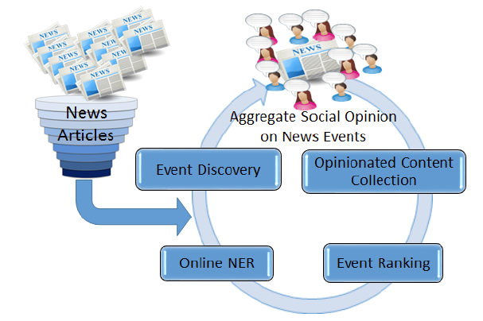
System Architecture (1)
1. Event Discovery
This component discovers interesting events from news articles that attract user engagement via comments.
It is a web crawler that continuously crawls Google News for top stories published on major news media. (BBC, Al Jazeera …)
Selects top-k frequent stories.
Events are refined continuously over time.
Same terms may refer to different events and different terms may refer to the same event!
Clustering events based on co-occurance and semantic distance.

Slide 53
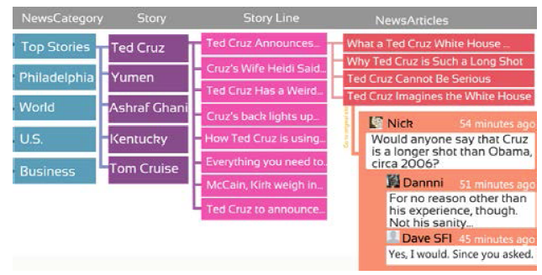
System Architecture (2)
2. Opinionated Content Collection
This component extracts users’ comments from news articles.
Currently supports 6 major news outlets.

Slide 54
System Architecture (3)
3. Event Ranking
In the current implementation only 20 top events are displayed. Ranking is done using below factors:
The number of news outlets covering the event.
The total time spent on being featured in Google News.
The rate of user comments.

Slide 55
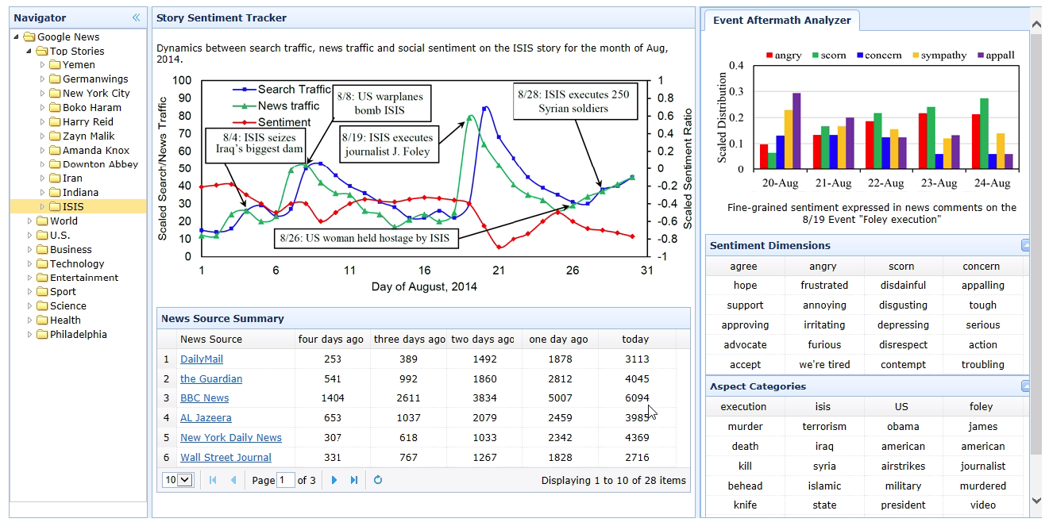
Demo

Slide 56
FLORIN – A System to Support (Near) Real-Time Applications on User Generated Content on Daily News
Presented by: Shahab Helmi
Fall 2015

Slide 57
Paper Info
Authors:
Andrew Crotty
Alex Galakatos
Emanuel Zgraggen
Carsten Binnig Tim Kraska
Department of Computer Science, Brown University
Publication:
VLDB 2015
Type:
Demonstration Paper

Slide 58
Introduction/Motivation
Visualizations are one of the most important tools for exploring, understanding, and conveying facts about data.
However, the rapidly increasing volume of data often exceeds our capabilities to digest and interpret it, even with sophisticated visualizations.
Traditional OLAP-style reporting can offer high-level summaries about large datasets but cannot reveal more meaningful insights.
Complex analytics tasks, such as machine learning and advanced statistics, can help to uncover hidden signals.
These techniques are not produce incredible insights on their own and must be guided by the user to unfold their full potential.
Selecting good features.
Tuning parameters by data scientist and domain experts: such as the number of centroids in k-means clustering or good Kernels for classifiers.

Slide 59
Introduction/Motivation (2)
Additionally, these ML algorithms rarely work in isolation, and they are usually combined into complex workflows involving preprocessing, training, and evaluation.
Existing frameworks are not designed for iteratively refining complex workflows in an interactive way and focus on executing a single algorithm at a time with fixed parameters.
Weka, Mahout, Mllib
Other tools like RapidMiner allow users to visually create ML workflows but are still far from delivering results within the interactivity threshold.
Vizdom a new system for interactive analytics through pen and touch.
The frontend allow users to interactively explore data using sophisticated visualizations. The backend leverages a high-performance distributed analytics framework to achieve interactive speeds.
New approximation techniques WILL BE ADDED to it for visualizing partial results.

Slide 60
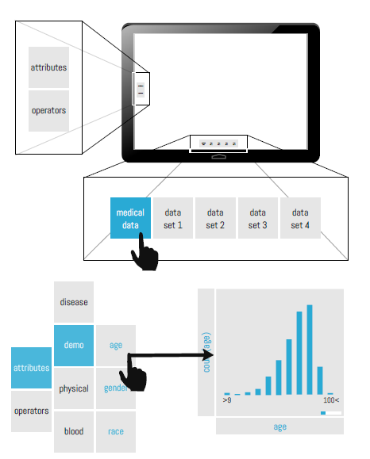
Architecture: Frontend
List of datasets at the bottom.
List of attributes and operators on the left.
User could filter data by pen.
User could add different operators and create a workflow.
User can see approximated results refined over time.

Slide 61
Architecture: Backend
Built on Tupleware, a new high-performance distributed analytics system that addresses the interactivity challenge through three key ideas:
Small Clusters: users will be able to see some results sooner.
Small Clusters:
As part of the compilation process, Tupleware dynamically generates all of the necessary control flow, synchronization, and communication code.
compiles workflows directly into self-contained distributed programs, improving performance by eliminating common sources of overhead (e.g., external function calls, polymorphic iterators)
applies traditional compiler techniques (e.g., inline expan- sion, SIMD vectorization)
Shared State: Tupleware uses the globally distributed shared state, which is a key ingredient of many ML algorithms.
Allows the system to stream results to the visual frontend specific points.

Slide 62
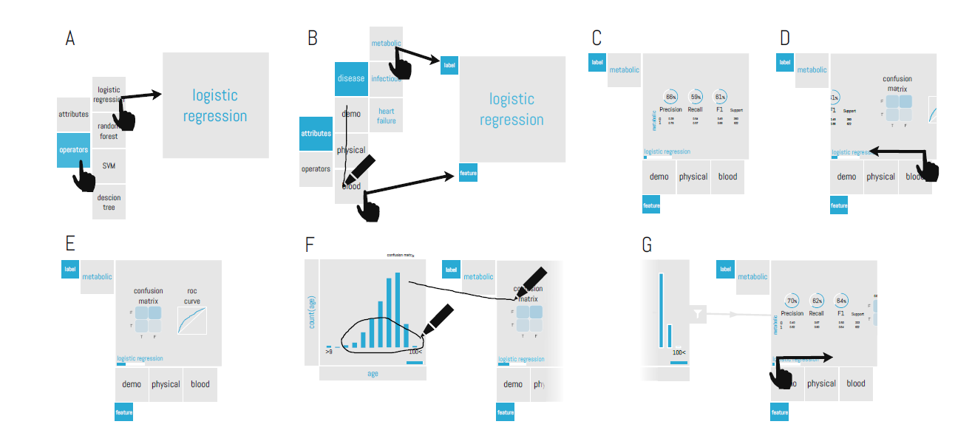
Demo

