Slide 2
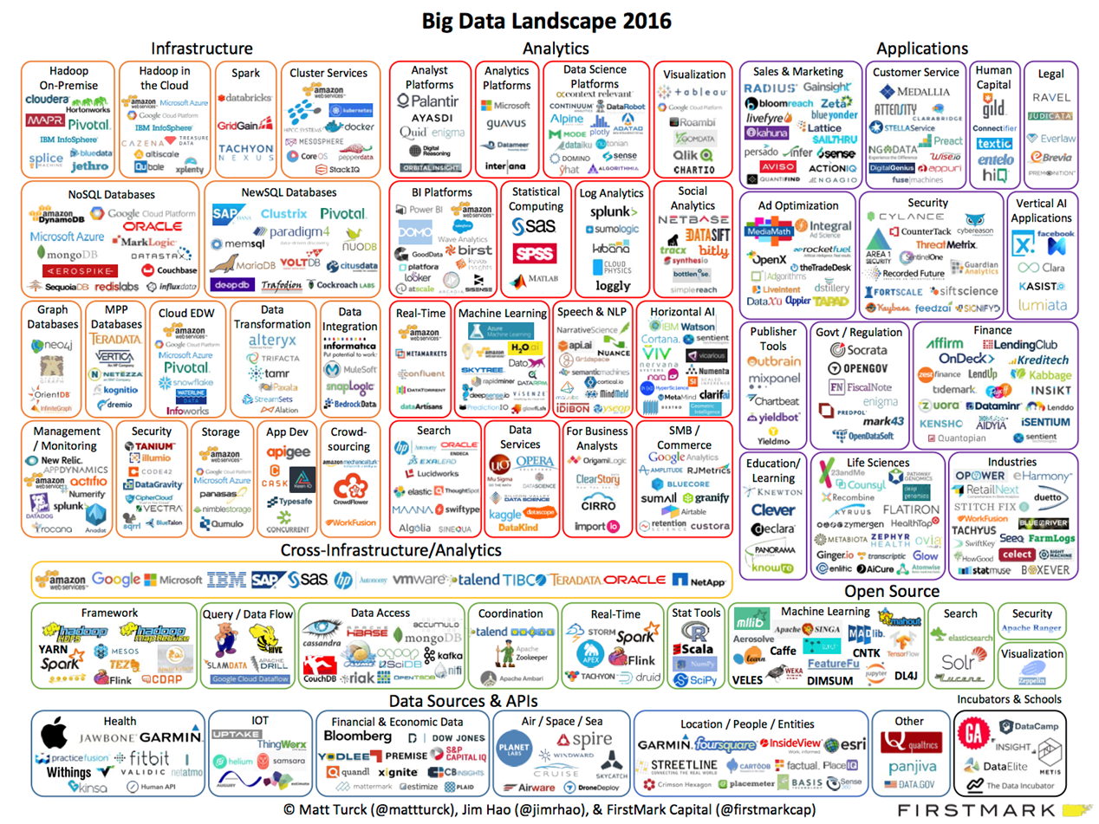

Slide 3
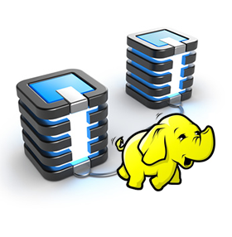
Limitation of Hadoop Map Reduce
HDFS
Read
HDFS
Write
HDFS
Read
HDFS
Write
Iter. 1
Iter. 2
Input
Map
Output
Slow due to replication
Inefficient for:
Iterative algorithms (Machine Learning, Graphs & network analysis)
Interactive Data Mining (R)
Reduce
Map
Reduce
Map

Slide 4
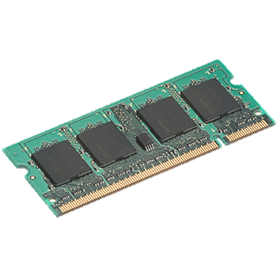
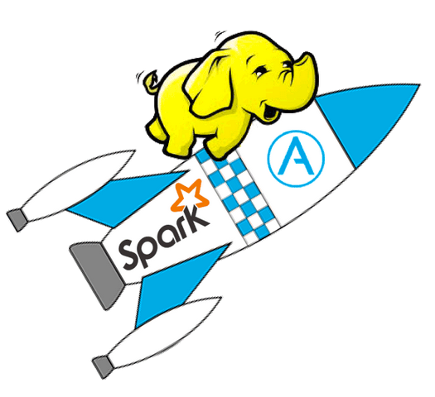
Why Spark as Solution: In-Memory Data Sharing
iter. 1
iter. 2
. . .
Input
query 1
one-time processing
query 2
query 3
Input
. . .

Slide 5
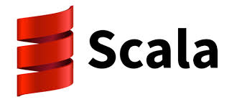
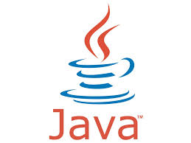
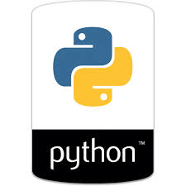
What is Spark
A Big Data analytics cluster-computing framework written in scala
Open sourced originally developed at AMP Lab @ UC Berkely
Provides In-Memory analytics which is faster than Hadoop/Hive (Up to 100x)
Designed for iterative algorithms and interactive analytics
Highly compatible with Hadoop’s storage APIs.
Can run on existing Hadoop Cluster Setup
Developers can write driver programs in using multiple languages

Slide 6
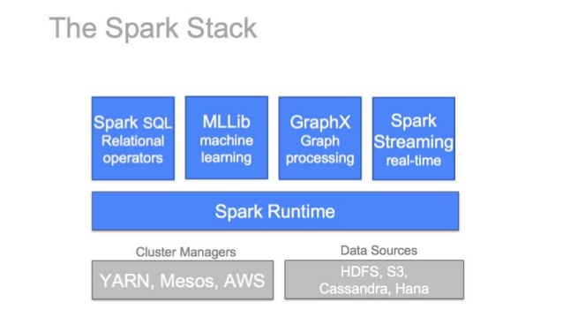
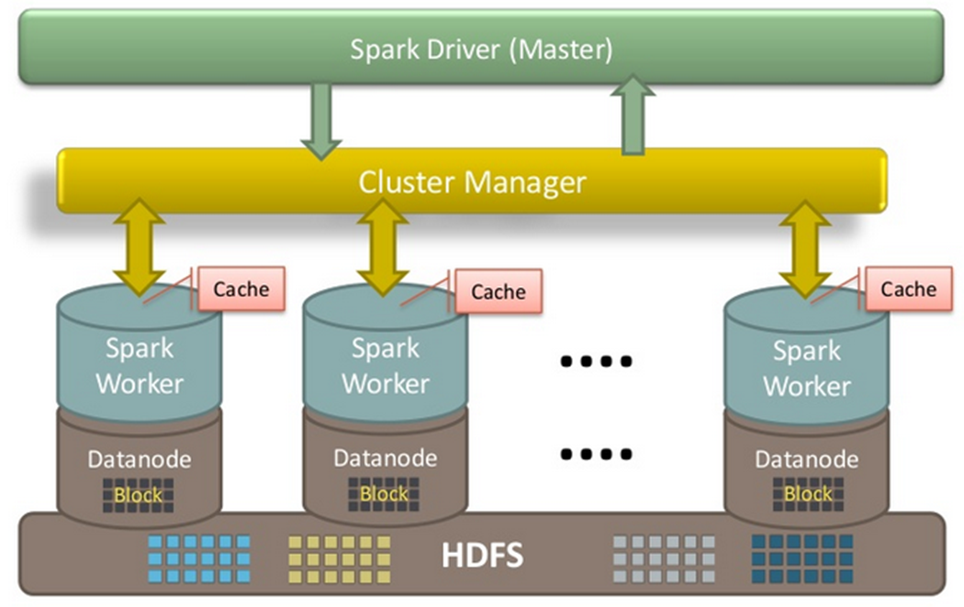
The Spark Stack & Architecture

Slide 7
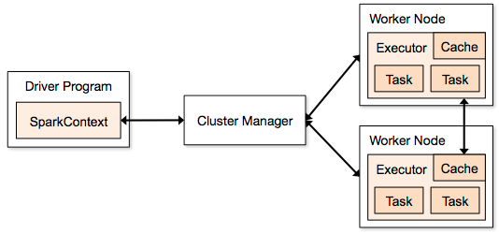
Core Spark Concepts
Spark Context: (Spark Context Object)
Driver programs access point.
Represents a connection to a computing cluster.
Used to build resilient distributed datasets or RDDs
RDD: Resilient Distributed Datasets
Immutable data structure
Fault Tolerant
Parallel Data Structure
In-Memory (Explicitly)
RDD
RDD
Input
RDD
RDD

Slide 8
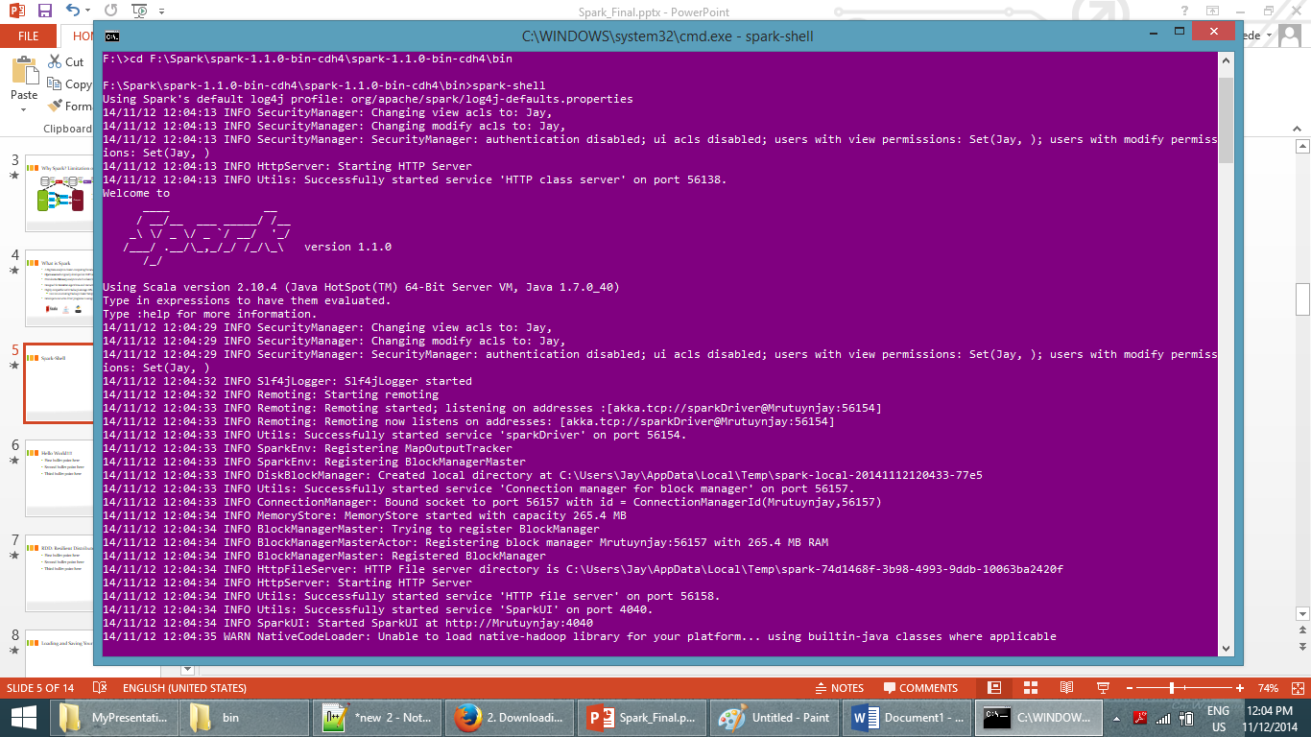
Spark-Shell

Slide 9
Hello World!! : Text Search
Spark Context
RDD is created
RDD Operation: Transformation
RDD Operation: Action

Slide 10
RDD: Resilient Distributed Dataset
An RDD in Spark is simply a distributed collection of objects.
Each RDD is split into multiple partitions, which may be computed on different nodes of the cluster.
RDDs can contain any type of Python, Java or Scala objects, including user-defined classes
RDD Created in two ways
1. Loading the external data
2. By distributing a collection of objects in from driver program
Operation on RDD:
Transformation: construct a new RDD from a previous one
Actions: compute a result based on an RDD, and either return it to the driver program or save it to an external storage system
Spark computes RDDs in a lazy fashion

Slide 11
Resilient Distributed Dataset Contd…
val lines = sc.textFile("README.md")
RDD
RDD
Action
Transformations
RDD
RDD
Value
pythonLines.count()
#3
pythonLines.first()
high-level APIs in Scala, Java, and Python, and an optimized engine that
val pythonLines = lines.filter(line => line.contains("Python"))

Slide 12
RDD Operations
Transformations
Create new dataset from and existing one
Lazy in nature. They are executed only when some action is performed
Example:
Map()
Filter()
Distinct()
Actions
Returns to the driver program a value or exports data to a storage system after performing a computation
Example:
Count()
Reduce()
Collect()
Take()
Persistence
For caching data in memory for future operations.
Options to store on disk or RAM or mixed (Storage Level)
Example:
Persist()
Cache()

Slide 13
RDD: Lazy Fashion & persist/Caching
Lazy Fashion:
RDDs are computed actually created the first time they are used in an action.
Persist:
Spark’s RDDs are by default recomputed each time you run an action on them.
Want to use RDD in multiple actions, ask Spark to store it in memory by using persist. i.e. RDD.persist()
RDD.unpersist(): To remove from the cache
Persisting RDDs on disk instead of memory is also possible
Level | Space Used | CPU time | In memory | On Disk | Nodes with data | Comments
MEMORY_ONLY | Low | Low | Y |  | 1
MEMORY_ONLY_2 | Low | Low | Y |  | 2
MEMORY_AND_DISK | High | Medium | Some | Some | 1 | Spills to disk if there is too much data to fit in memory.
DISK_ONLY | Low | High | N | Y | 1
DISK_ONLY_2 | Low | High | N | Y | 2

Slide 14
RDD Fault Tolerance
Spark keeps track of the set of dependencies between different RDDs, called the lineage graph.
It uses this information to compute each RDD on demand and to recover lost data if part of a persistent RDD is lost.

Slide 15
Spark Streaming
Framework for large scale stream processing
Scales to 100s of nodes
Can achieve second scale latencies
Integrates with Spark’s batch and interactive processing
Provides a simple batch-like API for implementing complex algorithm
Can absorb live data streams from Kafka, Flume, ZeroMQ, etc.

Slide 16
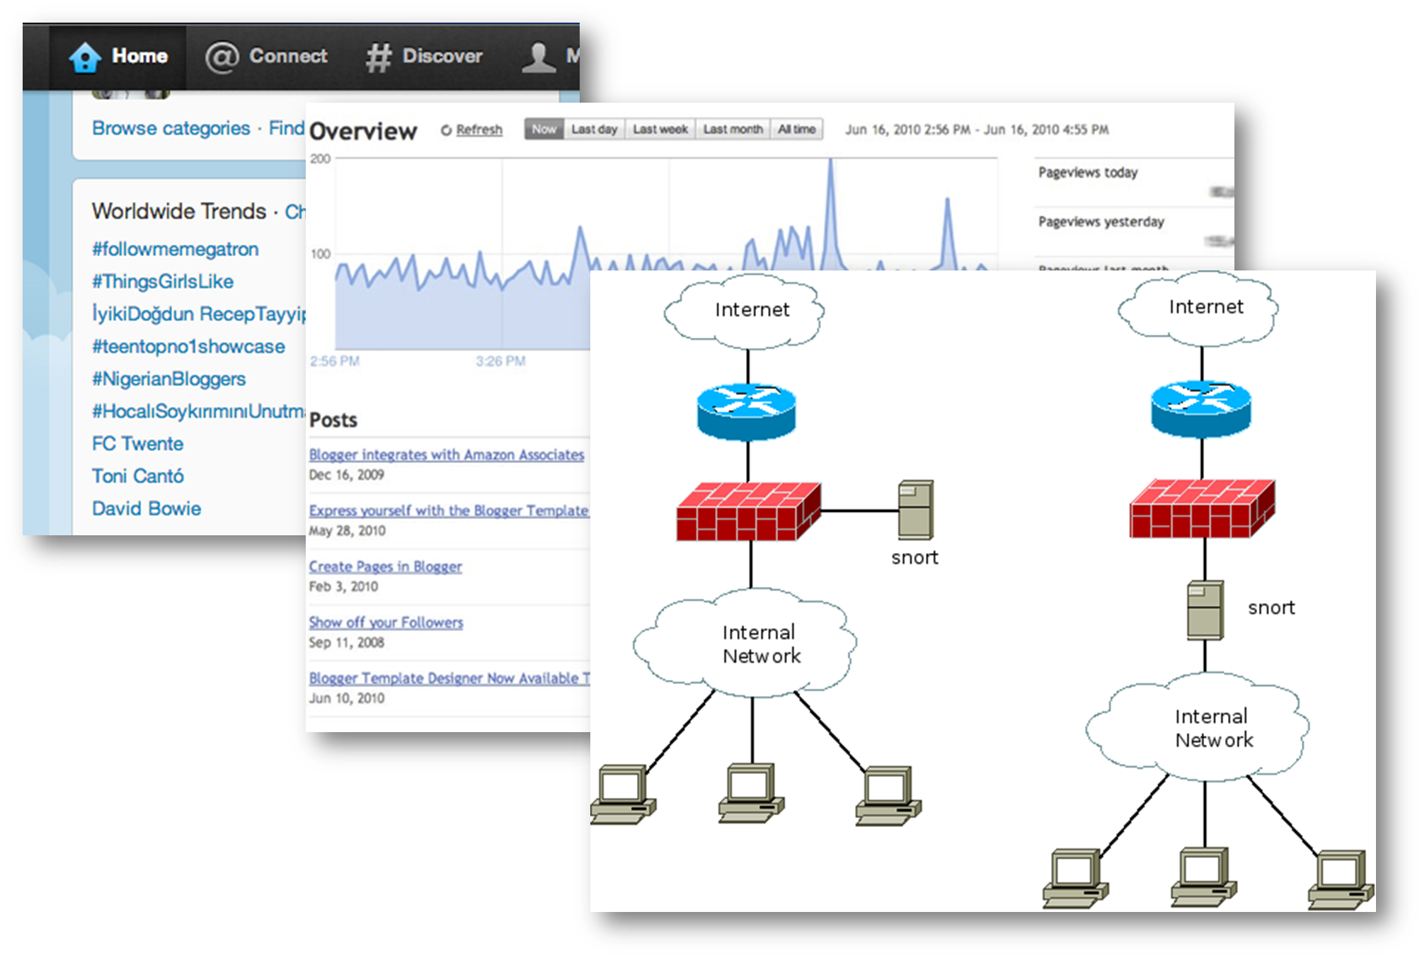
Motivation
Many important applications must process large streams of live data and provide results in near-real-time
Social network trends
Website statistics
Intrustion detection systems
etc.
Require large clusters to handle workloads
Require latencies of few seconds

Slide 17
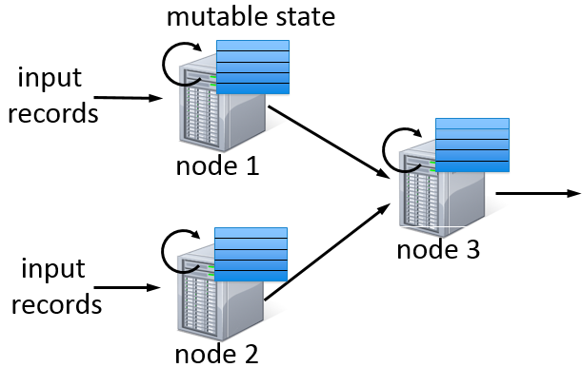
Stateful Stream Processing
Traditional streaming systems have a event-driven record-at-a-time processing model
Each node has mutable state
For each record, update state & send new records
State is lost if node dies!
Making stateful stream processing be fault-tolerant is challenging

Slide 18
Discretized Stream Processing
Run a streaming computation as a series of very small, deterministic batch jobs
live data stream
Spark
Streaming
Chop up the live stream into batches of X seconds
Spark treats each batch of data as RDDs and processes them using RDD operations
Finally, the processed results of the RDD operations are returned in batches
batches of X seconds
Spark
processed results

Slide 19
Discretized Stream Processing
Run a streaming computation as a series of very small, deterministic batch jobs
live data stream
Spark
Streaming
Batch sizes as low as ½ second, latency ~ 1 second
Potential for combining batch processing and streaming processing in the same system
batches of X seconds
Spark
processed results

Slide 20
Key concepts
DStream – sequence of RDDs representing a stream of data
Twitter, HDFS, Kafka, Flume, ZeroMQ, Akka Actor, TCP sockets
Transformations – modify data from on DStream to another
Standard RDD operations – map, countByValue, reduce, join, …
Stateful operations – window, countByValueAndWindow, …
Output Operations – send data to external entity
saveAsHadoopFiles – saves to HDFS
foreach – do anything with each batch of results

Slide 21
Example 1 – Get hashtags from Twitter
val tweets = ssc.twitterStream(<Twitter username>, <Twitter password>)
DStream: a sequence of RDD representing a stream of data
Twitter Streaming API
batch @ t+1
batch @ t
batch @ t+2
tweets DStream
stored in memory as an RDD (immutable, distributed)

Slide 22
Example 1 – Get hashtags from Twitter
val tweets = ssc.twitterStream(<Twitter username>, <Twitter password>)
val hashTags = tweets.flatMap (status => getTags(status))
new DStream
transformation: modify data in one Dstream to create another DStream
batch @ t
batch @ t+1
batch @ t+2
tweets DStream
flatMap
flatMap
flatMap
hashTags Dstream
[#cat, #dog, … ]
new RDDs created for every batch
…

Slide 23
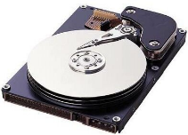
Example 1 – Get hashtags from Twitter
val tweets = ssc.twitterStream(<Twitter username>, <Twitter password>)
val hashTags = tweets.flatMap (status => getTags(status))
hashTags.saveAsHadoopFiles("hdfs://...")
output operation: to push data to external storage
batch @ t
batch @ t+1
batch @ t+2
tweets DStream
flatMap
flatMap
flatMap
hashTags DStream
save
save
save
every batch saved to HDFS

Slide 24
Fault-tolerance
RDDs are remember the sequence of operations that created it from the original fault-tolerant input data
Batches of input data are replicated in memory of multiple worker nodes, therefore fault-tolerant
Data lost due to worker failure, can be recomputed from input data
tweets
RDD
input data replicated
in memory
flatMap
hashTags
RDD
lost partitions recomputed on other workers

Slide 25
Spark: Machine Learning (MLlib)
MLlib is a standard component of Spark providing machine learning primitives on top of Spark
Algorithms supported by Mllib
Classification: SVM
Regression: Linear Regression, and random forests
Collaborative Filtering: Alternating Least Squares (ALS)
Clustering: K-means
Dimensionality Reduction: Singular Value Decomposition (SVD)
Basic Statistics: Summary Statistics, correlation, hypothesis testing
Feature Extraction and Sampling:

Slide 26
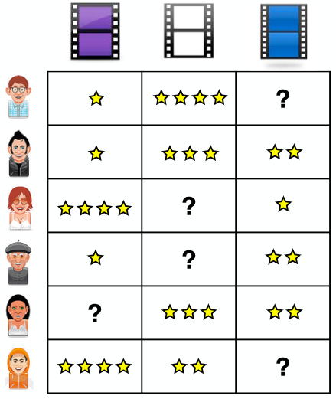
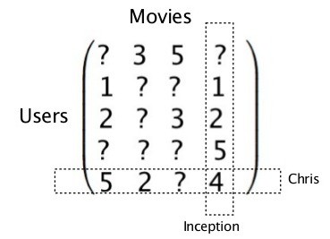
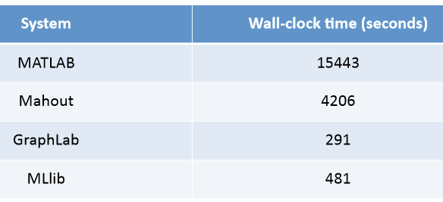
Collaborative Filtering
Recover a rating matrix from a subset of its entries.
ALS - wall-clock time

Slide 27
Collaborative Filtering

Slide 28
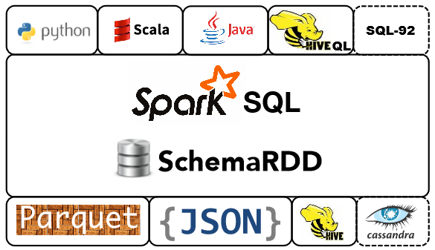
Spark SQL
Spark SQL unifies access to structured data.
Load and query data from a variety of sources
Run unmodified Hive queries on existing warehouses
Connect through JDBC or ODBC.
Spark SQL includes a server mode with industry standard JDBC and ODBC connectivity.

Slide 29
The Spark Community

Slide 30
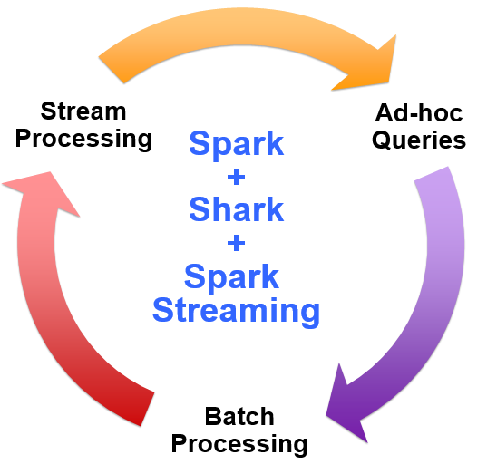
Vision - one stack to rule them all

Slide 31
A New Feature Addition to MLlib
ELM: Extreme Learning Machine.
A latest and fast learning method.
Based Single Layer Neural Network model.
Works 100x faster than the Backpropgation algorithm
More training accuracy compared SVM*
It used Singular Value Decomposition (SVD) for computation which is already supported by Spark MLlib
Very recent research publications (2014) prove parallel and distributed model of ELM

Slide 32
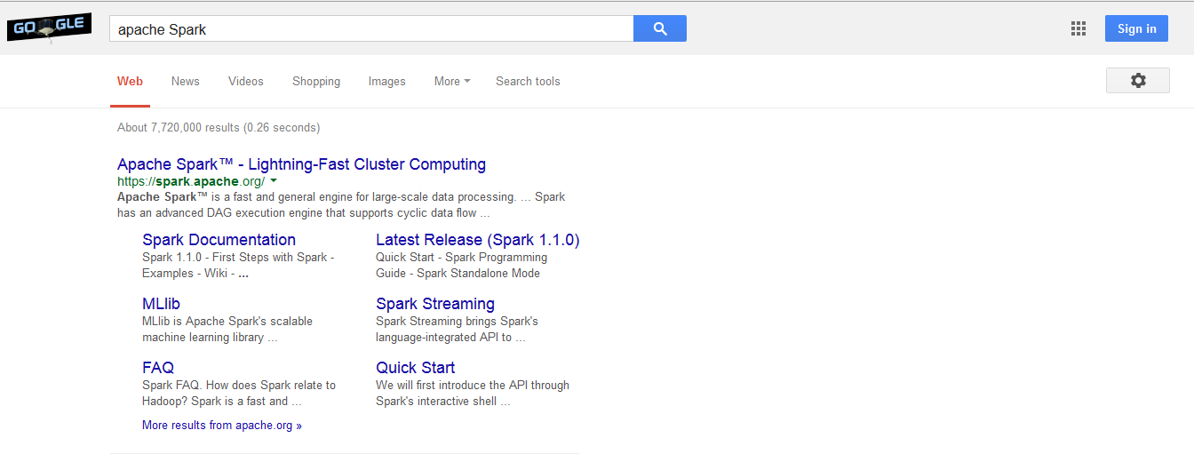
References (google Apache Spark)

Slide 33
Question?

Slide 34
Thank You!!!!
Video About Google:
https://www.youtube.com/watch?v=p0ysH2Glw5w

