Slide 1
CSCI-4565/5565: OpenGL + Qt (interfaces)
+
Shane Transue, PhD – Graphics/Physics Simulation

Slide 2
Setting up Qt + OpenGL + Visual Studio
Download VS Qt Plugin 2017:
https://marketplace.visualstudio.com/items?itemName=TheQtCompany.QtVisualStudioTools-19123
2019: https://marketplace.visualstudio.com/items?itemName=TheQtCompany.QtVisualStudioTools2019
1
Download Visual Studio
https://visualstudio.microsoft.com/downloads/
2
3
Download Qt (Open-Source)
https://www.qt.io/download https://www.qt.io/download-qt-installer
Installing in this order – usually leads to no problems
Be sure to match each version (ex: VS2017, QtVS2017, VS Qt Plugin 2017)
Introduction to Graphics: Qt and OpenGL

Slide 3
Setting up Qt + OpenGL + Visual Studio
Installation Notes: We will use Qt 5.12 with Visual Studio 2017 (for stability)
Download the open source version (Qt 5.12 is a large download ~3.7GB)
You now have to make a Qt Account
The main downloads page will send you to the online installer for Qt6 which is currently unstable
This can be used with Visual Studio 2019
TO DOWNLOAD Qt 5.12
Download name should be something like: qt-opensource-windows-x86-5.12.10.exe
Offline installer: https://www.qt.io/offline-installers
Mirrors: If you are having trouble (speed or hash errors) try a mirror: https://download.qt.io/official_releases/qt/5.12/5.12.10/qt-opensource-windows-x86-5.12.10.exe.mirrorlist
Introduction to Graphics: Qt and OpenGL

Slide 4
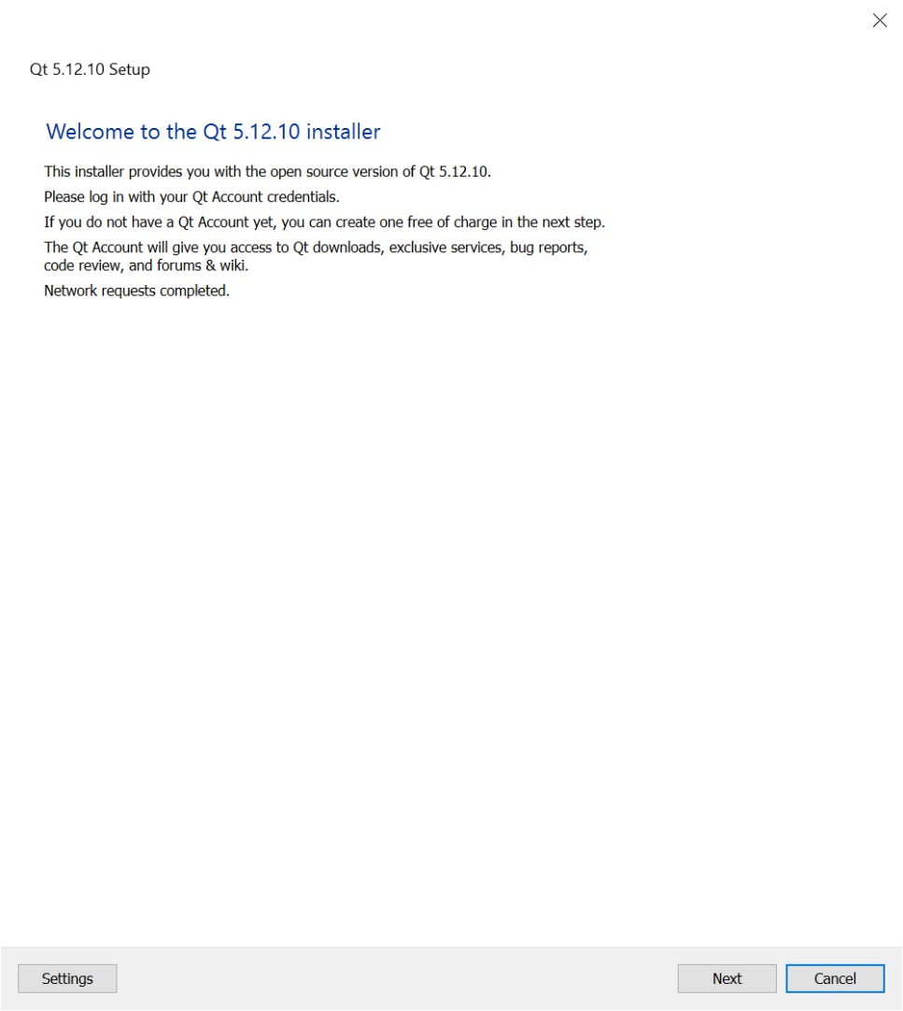
Side-note: Setting up Qt + OpenGL + Visual Studio
This is the download for Qt 5.12
Works with VS2017
Offline installer is the best bet
This is the installer we want to use
Introduction to Graphics: Qt and OpenGL

Slide 5
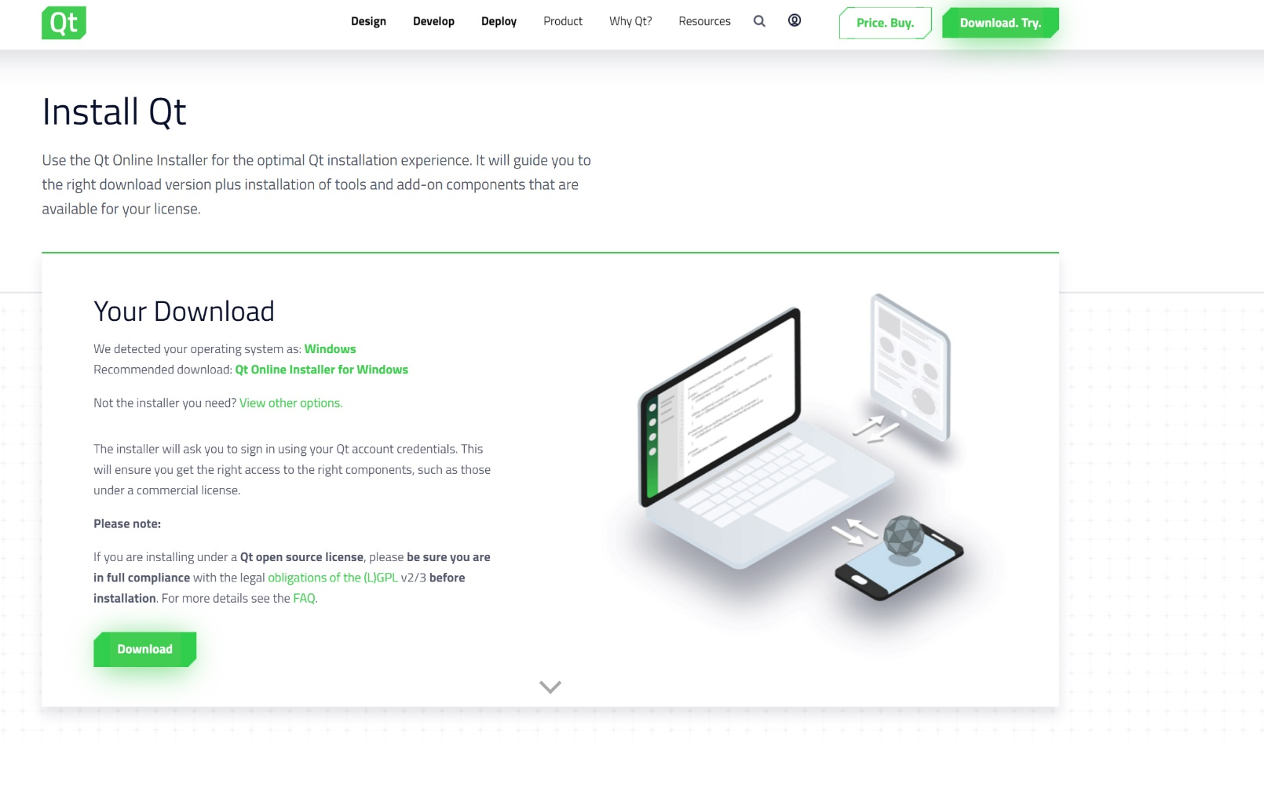
Side-note: Setting up Qt + OpenGL + Visual Studio
This is the download for Qt6
Qt6 will work with VS2019
BUT!
Installer may encounter errors
Introduction to Graphics: Qt and OpenGL

Slide 6
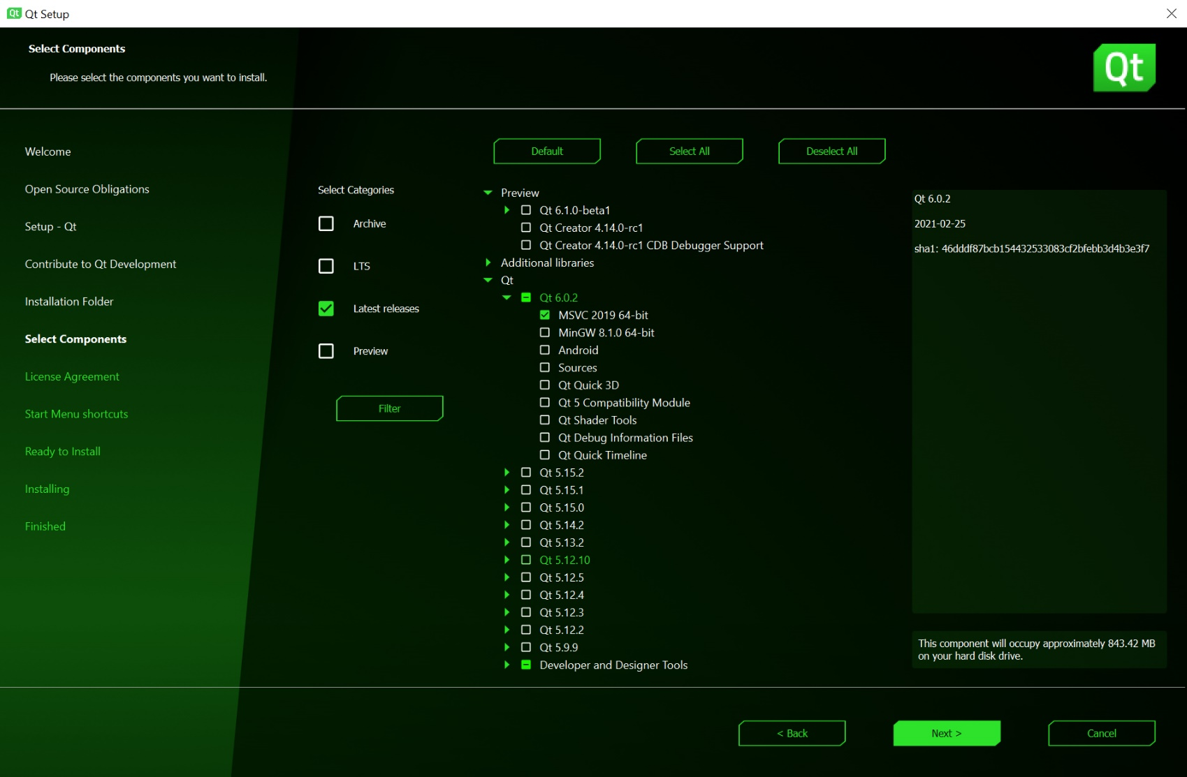
Side-note: Setting up Qt + OpenGL + Visual Studio
This is the setup for Qt6
Qt6 will work with VS2019
BUT!
Installer may encounter errors
Introduction to Graphics: Qt and OpenGL

Slide 7
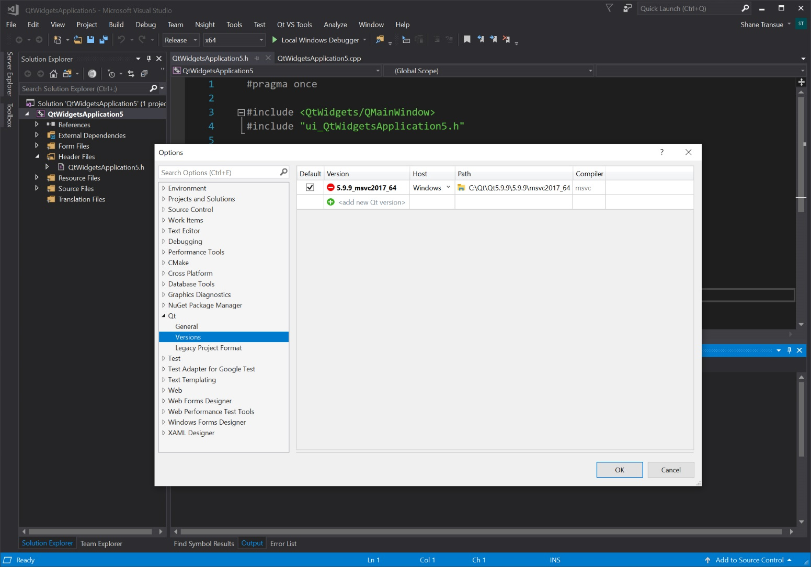
Setting up Qt + OpenGL + Visual Studio
Once all 3 are installed:
Qt, VS, Qt-VS Plugin
Setup a Qt version: => Qt VS Tools => Qt Versions => Set path to your installation
Introduction to Graphics: Qt and OpenGL

Slide 8
Qt: TLDR
What? A cross-platform UI framework
Like: wxWidgets, FLTK, Tk, etc. (Much more than GLUT!)
Available for: C+, Python, Go, Haskell, etc.
Q
t
= ‘Cute’ or Cutie?
Introduction to Graphics: Qt and OpenGL

Slide 9
Qt: TLDR
What? A cross-platform UI framework
Like: wxWidgets, FLTK, Tk, etc. (Much more than GLUT!)
Available for: C+, Python, Go, Haskell, etc.
Why? Develop your applications interface once, deploy to all systems
Support: Windows, Mac, Linux – (Mac/Linux can use Creator IDE)
Easy to use
Easy to customize – Qt CSS
Easy to design complex interfaces (no code bloat, limited crazy macros)
Coding Configuration:
Visual Studio 201X
Qt v >= 5.12
Visual Studio Qt Plugin
Introduction to Graphics: Qt and OpenGL

Slide 10
Qt: TLDR
What? A cross-platform UI framework
Like: wxWidgets, FLTK, Tk, etc. (Much more than GLUT!)
Available for: C+, Python, Go, Haskell, etc.
Why? Develop your applications interface once, deploy to all systems
Support: Windows, Mac, Linux – (Mac/Linux can use Creator IDE)
Easy to use
Easy to customize – Qt CSS
Easy to design complex interfaces (no code bloat, crazy macros)
What is the catch? Is not free
Commercial license – quite expensive
Alternative: Qt Open source (LGPL)
Open source works for what we need
Much better to learn than many other frameworks (less overhead)
Coding Configuration:
Visual Studio 201X
Qt v >= 5.12
Visual Studio Qt Plugin
Introduction to Graphics: Qt and OpenGL

Slide 11
Designing Graphics Interfaces: Freeglut [vs] Qt
Programming in Qt is different than GLUT
FreeGlut (the modern version) is severely limited (mouse + keyboard + context menu)
Need a lot more control (controls, buttons, etc.)
A very long list of everything else..
Program Structure: Qt changes how to write the code, but it’s the same (init, display, resize)
OpenGL Code
Qt Application/Widgets
Main
Custom objects
Rendering code
Manages things that go in a viewport
Defines app. features, layout
Contains controls, functionality
Defines how viewports behave
Glut: Everything goes here
Qt: Don’t really need to touch this
Unless you want a splash screen
Introduction to Graphics: Qt and OpenGL

Slide 12
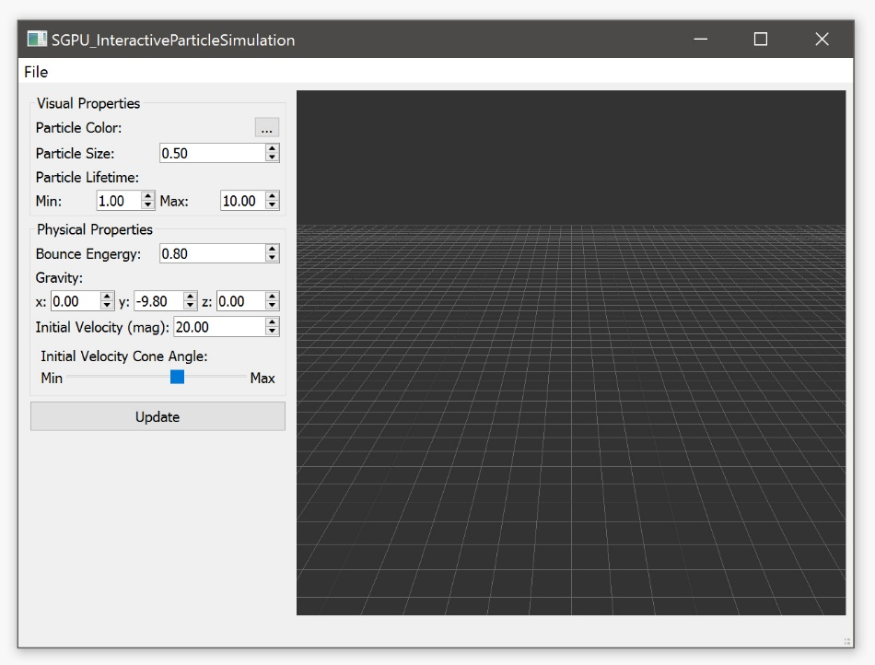
Qt: TLDR
Example Qt App
How to use Qt? Numerous methods
Qt Creator Oriented: (Design, compiling, running, etc.)
Code Oriented: Design in Qt Designer, code in Visual Studio
Why?: Develop everything in code, minimize UI
Only need signal slots, basic UI classes
What do we need to know - Concepts
Basic UI development and controls
OpenGL Integration (Qt specific)
Signals/slots
Basic OpenGL application + UI
Introduction to Graphics: Qt and OpenGL

Slide 13
Qt: Design + MOC
Development Code/Design
Application Code (Your code)
Automated through VS/Qt Creator
*.h files
*.cpp files
Meta Object Compiler
(MOC Compiler)
Generated Files
C++ Compiler
moc_*.cpp
Generated Files
(don’t touch!)
Compiles all files together (normally)
Designer Files
Generates Qt
specific files
*.ui (Qt Interface)
*.res (Resources)
User Interface Design
(Qt Designer)
Executable
Windowed Application
Introduction to Graphics: Qt and OpenGL

Slide 14
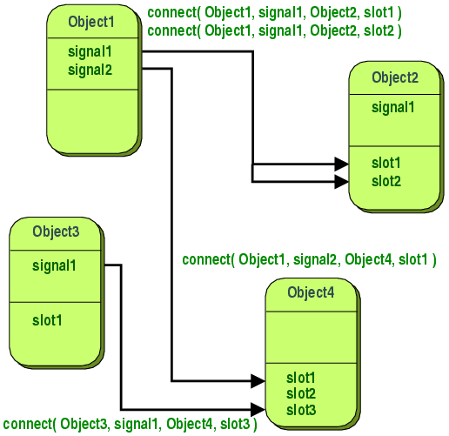
Qt: The concept of Signals and Slots (event routing)
Signals: Generated events tied to an object (sent to a slot)
Ex: Button click (event = user clicked a button)
Sent by button, signal = on release
Slots: Captures events, defined as a callback
Qt does this internally
Ex: Button click callback
Receiver/slot = a function within your class
Connect: Attach (plug in) a signal to a slot
Provided in all Qt objects
Signals:
Slots:
Introduction to Graphics: Qt and OpenGL

Slide 15
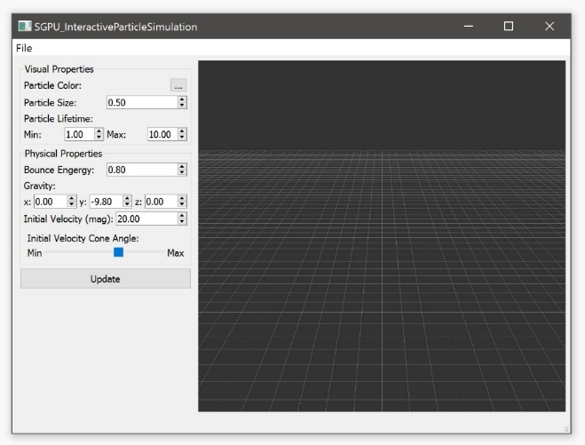
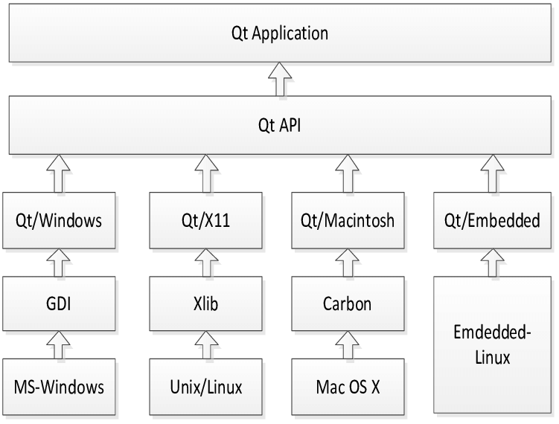
Qt: Architecture TLDR
Your code
Cross-platform
Introduction to Graphics: Qt and OpenGL

Slide 16
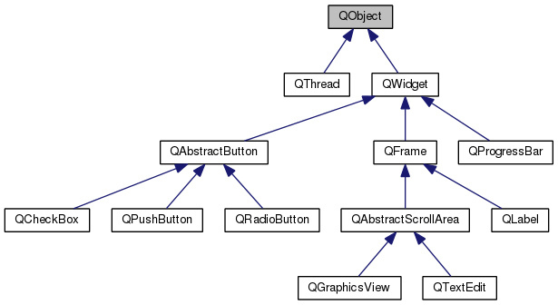
Qt: TLDR Class Hierarchy
QOpenGLWidget
Everything is a QObject, most of the time you will use QWidgets for UI
Introduction to Graphics: Qt and OpenGL

Slide 17
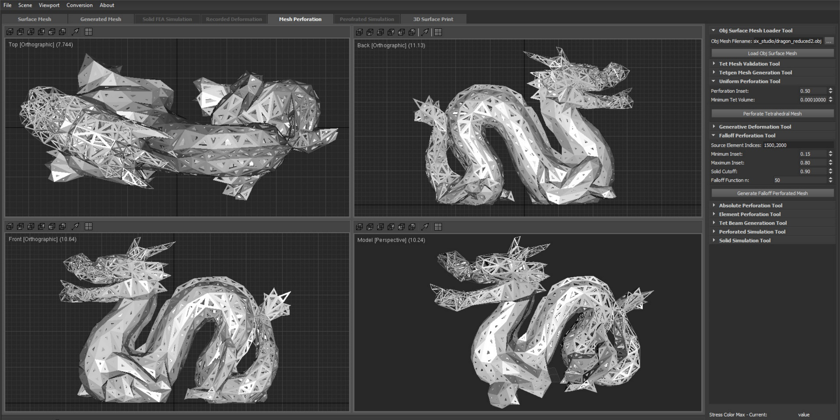
Qt Example: px-studio: 3D printing elastic materials
Introduction to Graphics: Qt and OpenGL

Slide 18
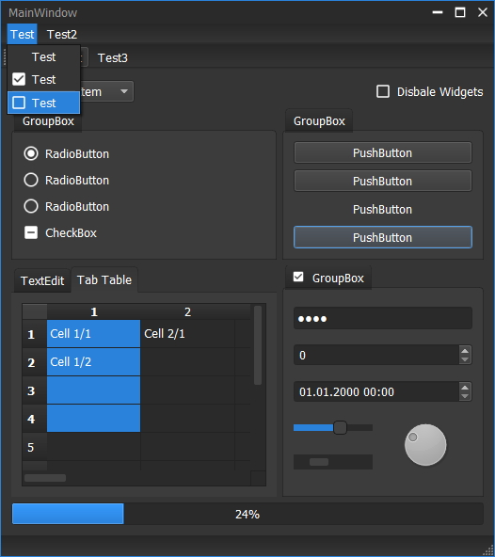
Qt + OpenGL: UI Customization through CSS
CSS: Easily customize, design UI elements
Works almost exactly like you would think
Provides custom selectors for Qt things
All controls can be customized
Example →
How: Qt Designer
Select a UI widget in the designer, change CSS
For example: background-color: rgb(100, 100, 100);
Introduction to Graphics: Qt and OpenGL

Slide 19
Designing Graphics Interfaces: OpenGL + Qt
What we will cover (an easy way of):
Creating a basic window (Independent of IDE, using Designer)
Create a custom OpenGL viewport class
Add some graphics
Add some controls
Tie them together and change graphics based on user interface controls (signals/slots)
Introduction to Graphics: Qt and OpenGL

Slide 20
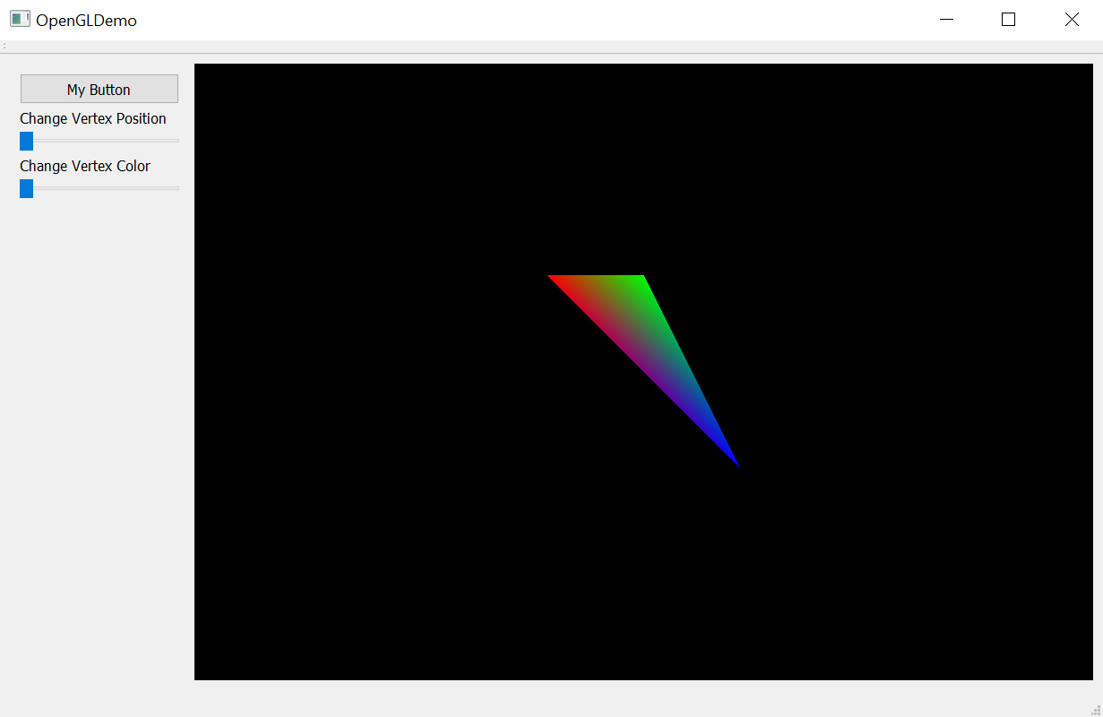
Designing Graphics Interfaces: OpenGL + Qt
Introduction to Graphics: Qt and OpenGL

Slide 21
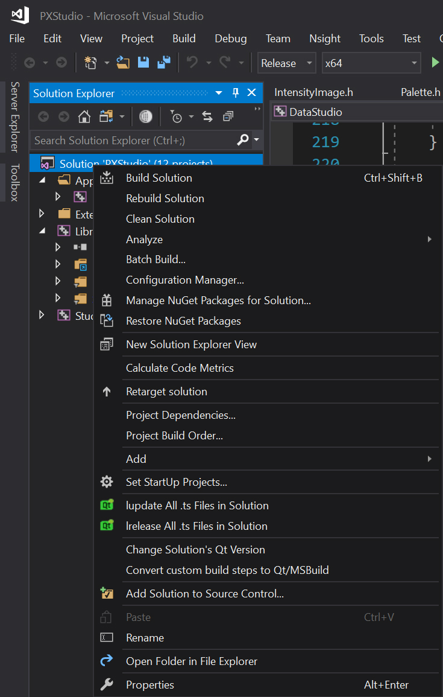
Designing an OpenGL UI with Qt: Additional Notes
Qt Version Selection (comes up when opening new Qt projects)
Right-click on the solution
Change Solution’s Qt Version
Introduction to Graphics: Qt and OpenGL

Slide 22
Designing an OpenGL UI with Qt: Additional Notes
When creating a Qt OpenGL project, you may have to add: opengl32.lib and glu32.lib to Properties → Linker → Input → Additional Dependencies
Qt creator has its own set of project files (*.pro, etc.) for Qt
You can use QOpenGLFunctions, but its not required (use OpenGL commands you are familiar with)
Don’t forget Qt specific things in code: Q_OBJECT, public slots, etc.
Introduction to Graphics: Qt and OpenGL

